Slide 1
Case Study – PyUnit
Focus:
Unit Testing using PyUnit

Slide 2
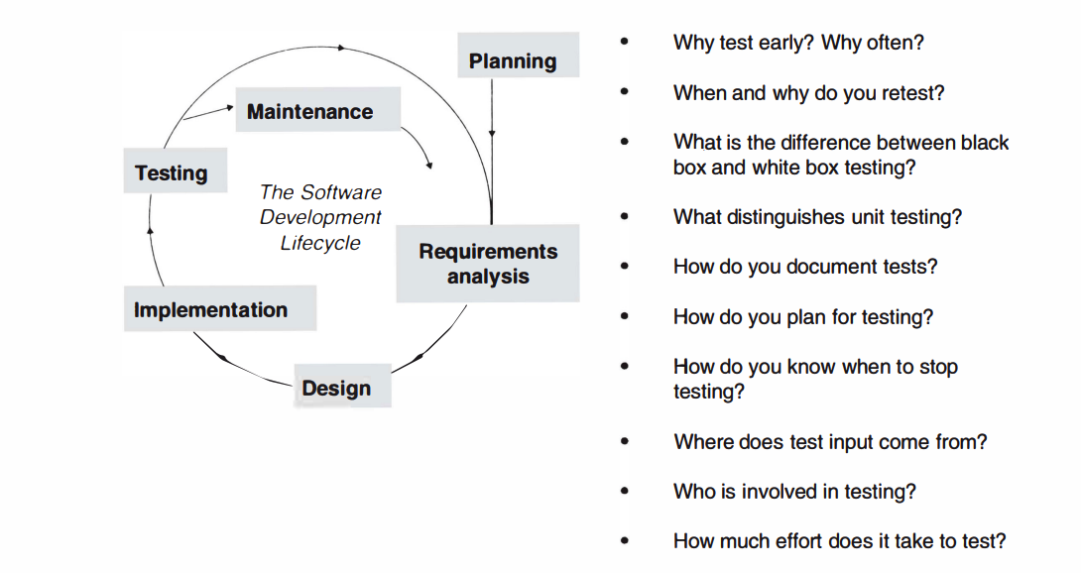

Slide 3


Introduction to PyUnit
PyUnit is the Python standard library module for unit testing, also known as the unittest module.
Inspired by JUnit (Java) and part of the xUnit family of testing frameworks.
Built into Python, so no external dependencies are required.
Provides a structured way to write and execute test cases.
Supports test automation, setup/teardown processes, and comprehensive reporting.

Slide 4
Introduction to PyUnit
What is Unit Testing?
Importance of Automated Testing.
PyUnit: Python’s Built-in unittest Framework.
Key Features: Isolated, Repeatable, Automatable.
Individual unit test methods contained within each TestCase class

Slide 5
Steps to Create a Test Case:
Import unittest.
Create a class inheriting from unittest.TestCase.
Write test methods starting with test_.
Example: Testing a simple data fetch function.
Run tests with unittest.main().

Slide 6
Useful Features of PyUnit
Assertions:
assertEqual, assertTrue, assertRaises, etc.
Test Fixtures:
setUp() and tearDown() methods.
setUpClass() and tearDownClass() for global setup.
Skipping Tests:
@unittest.skip, @unittest.skipIf.

Slide 7
Running and Organizing Tests
Running Tests:
Command Line: python -m unittest.
Automatic Test Discovery.
Organizing Tests:
File structure for large projects.
Grouping related tests into classes or modules.

Slide 8
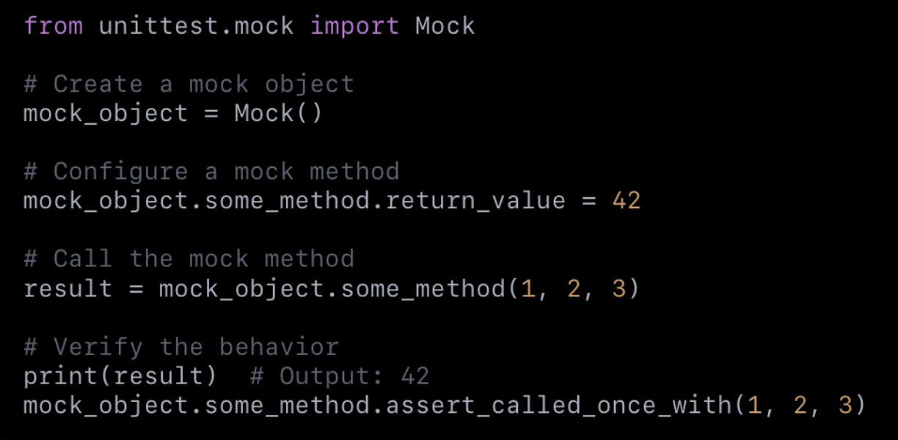
Best Practices & Summary
Best Practices:
Write isolated and concise tests.
Test edge cases and error handling.
Use Mocks for dependencies.
Summary:
PyUnit ensures reliable and repeatable testing.
Essential for high-quality software.
Explore advanced tools like pytest for more features.

Slide 9

Tools: Git
One very important tool for software development is GIT.
We use Git Repositories (aka "repos") to store code and collaborate.
I have put the class example and some slides in a Git Repo!
There are TWO ways you can access the repo.
You must first install Git. Download and install it:
https://git-scm.com/downloads
If we don't have time to do this in class please try this on your own.
Learning to use Git is a very important skill for anyone working with code

Slide 10
Tools: Git
Now that we have Git installed, we can "clone the repo"
That means: download a copy of the code to my computer
What does the repo look like?
https://github.com/armcnty/COMP2663
There are two (or more!) ways to do this:
If you prefer the command prompt... see the next slide

Slide 11
Tools – Cloning the Repo
Using the command line, you can execute the following:
git clone https://github.com/armcnty/COMP2663
You’ll now have a new COMP2663 folder with all the necessary code and distribution material that I have chosen to share in this repository.

